Slide 1
Mobile Industry; Manufacturing Environmental Scan Survey;
2007
Prepared by:
Alexander Cope
Contributors:
Doug Powell
Todd Harris
Connos Tai
Dan Burkholder
Chris Combs
KK Tang
Shawn Shi
February 2007

Slide 2
Content…
Objectives
Customers Surveyed
Key ODM / OEM Pairings
Assembly Capability
ODM Line Configurations
Screen Printing
SMT Placement
Reflow
Glue and Underfill
BGA Rework
PCB Board Technologies
Packaging
Quality Assessment
Max BGA Size & Ball Count per Pitch
BGA Opens at Different Pitches
BGA Shorts at Different Pitches
BGA Package Size and Ball Count
QFP Yields
BGA Corner Ball Cracking
Test Capabilities and Procedures
  AOI / AXI
  ICT
  ATE
  Device Programming
  Functional Test
  Manufacturing Stress
PEI (Product Environmental Initiative) – Test Conditions
Shock
Vibration
Mechanical Fatigue
Thermal Cycling
Humidity and Temperature
Constant Elevated Temperature
Electroshock / ESD
Information Source
Backup

Slide 3
Objectives
Share and document teams findings from capability survey.
Compile collected data from 5 major mobile ODM’s.
Highlight key learnings that can be leveraged in future enabling efforts.

Slide 4
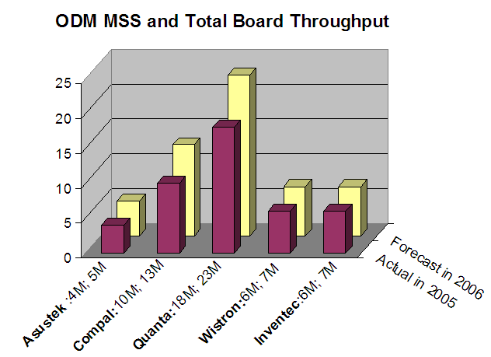
Customers Surveyed…
Mobile Market Share
35%
Quantity of Boards Manufactured (M)
20%
33%
18%
11%
11%
8%
7%
11%
11%
ODM: ’05 Revenue; Forecasted ’06 Revenue
Other ODM’s make up for roughly 15% of mobile market in 2006.

Slide 5
Key ODM / OEM Pairings:
Works With |  | ODM HQ Loc. Mfg. Loc. | Quanta Taiwan Shanghai, China | Compal Taiwan Kunshan, China | Inventec Taiwan Shanghai, China | Wistron Taiwan Kunshan, China | Asustek Taiwan Shanghai, China
 | Number Of Employees |  | ~35,000 | ~17,000 | ~26,000 | ~20,000 | ~52,000
OEM HQ Loc. |  | 2006 FY Revenue | 14.9 B | 6.76 B | 4.47 B | 4.04 B | 3.64 B
Dell Texas, US | ~70,000 | ~55.9 B | ✓ | ✓ |  | ✓
HP California, US | ~150,000 | ~91.7 B | ✓ | ✓ | ✓
Acer Taipei, Taiwan | ~6,000 | ~12.42 B | ✓ | ✓ |  | ✓
Apple California, US | ~17,000 | ~15.3 B | ✓ |  |  |  | ✓
Sony Tokyo, Japan | ~158,500 | ~72 B | ✓ |  |  |  | ✓
Lenovo New York, US | ~19,000 | ~14.8 B | ✓ | ✓ |  | ✓
Toshiba Tokyo, Japan | ~165,000 | ~56 B | ✓ | ✓ | ✓
NEC Tokyo, Japan | ~154,000 | ~42 B | ✓ | ✓

Slide 6
Assembly Capability
ODM Line Configurations:
Inventec
Assembly Side 1
Board Handler | Paste Printer | Glue Dispenser | Chip PnP | BGA PnP | VI | SMT Reflow | Buffer | AOI | Buffer | VI
Sun SDA SVP-750 | DEK Infinity AP | Panasonic NM-DC15 | 3 Panasonic CM402 | Universal GSM2 | Human Eyes (Manual) | Heller 1900 EXL | N/A | TRI | Human Eyes (Manual) | Manual (UV Glue)
Assembly Side 2
Paste Printer | Solder Paste Inspection | Chip PnP | BGA and Connector PnP | VI | SMT Reflow | Buffer | AOI | Buffer | VI | Corner Glue | ATE | FCT
DEK Infinity AP | TRI TR-7006 | 4 Panasonic KXF – 4F4C | Universal GSM2 | Human Eyes (Manual) | Heller 1900 EXL | N/A | TRI TR-7100 | N/A | Human Eyes (Manual) | Manual (UV Glue) | N/A | N/A

Slide 7
Assembly Capability
ODM Line Configurations:
Quanta
Assembly Side 1
Board Handler | Paste Printer | Scanning Printer Inspection | Chip PnP | Corner Glue Underfill Dispenser | BGA PnP | SMT Reflow | Buffer | AOI | Buffer | VI
ABS – 1000M | DEK Infinity AP | Fuji NXT | TBD (Fuji?) | Fuji NXT | TBD | N/A | Saki | N/A | Human Eyes (Manual) | Manual (UV Glue)
Assembly Side 2
Paste Printer | Scanning Printer Inspection | Chip PnP | Corner Glue Underfill Dispenser | BGA and Connector PnP | SMT Reflow | Buffer | AOI | Buffer | VI | ATE | FCT
DEK Infinity 2000 | Cyber SE3000 | Fuji NXT | TBD (Fuji?) | Fuji NXT | TBD | N/A | TRI TR-7100 | N/A | Human Eyes (Manual) | N/A | N/A

Slide 8
Assembly Capability
ODM Line Configurations:
Wistron
Assembly Side 1
Board Handler | Paste Printer | Corner Glue Dispenser | Scanning Printer Inspection | Chip PnP | BGA PnP | SMT Reflow | Buffer | AOI | Buffer | VI
SUN SDA SVP - 750 | DEK Infinity AP | Camalot 5000 | Cyber SE3000 | 5 Panasonic CM402 | Panasonic DT401 | Furukawa XN1245 | N/A | Optima 7300 | N/A | Human Eyes (Manual)
Assembly Side 2
Paste Printer | Corner Glue Dispenser | Scanning Printer Inspection | Chip PnP | BGA and Connector PnP | SMT Reflow | Buffer | AOI | Buffer | VI | De-Paneling | ATE | FCT
DEK Infinity AP | Camalot 5000 | Cyber SE3000 | 5 Panasonic CM402 | Panasonic DT401 | Furukawa XN1245 | N/A | Optima 7300 | N/A | Human Eyes (Manual) | Aurotek R-S168SA | N/A | N/A

Slide 9
Assembly Capability
ODM Line Configurations:
Compal
Assembly Side 1
Board Handler | Paste Printer | Corner Glue Dispenser | Scanning Printer Inspection | Chip PnP | BGA PnP | SMT Reflow | Buffer | AOI | Buffer | VI
N/A | DEK 265 | EL EM5701N | N/A | 4 Fuji 743-E | Universal GSM1 | BTU Prymax 150 | N/A | Teradyne | N/A | Human Eyes (Manual)
Assembly Side 2
Paste Printer | Glue Dispenser | Scanning Printer Inspection | Chip PnP | BGA and Connector PnP | SMT Reflow | Buffer | AOI | Buffer | VI
DEK 265 | EL EM5701N | N/A | 4 Fuji 743-E | 2 GSM1 | BTU Prymax 150 | N/A | Teradyne | N/A | Human Eyes (Manual)
Offline Corner Glue Process
Corner Glue Dispenser | UV Cure Of Corner Glue | ATE | FCT
EL EM5701N | N/A | N/A | N/A

Slide 10
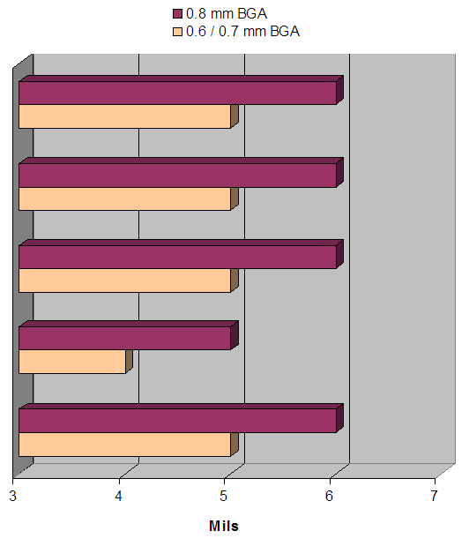
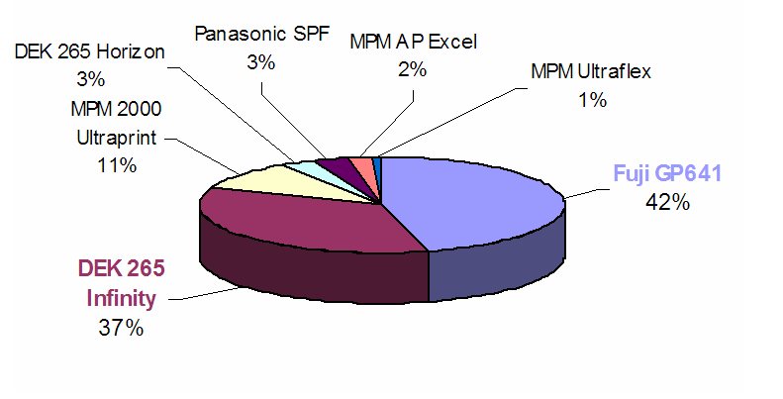
Assembly Capability:
Screen Printer Equipment
Stencil Thickness for .6 / .7 mm pitch BGA
Screen Printer Distribution

Slide 11
Assembly Capability:
Screen Printer Equipment
Printing and Paste
 | Inventec | Wistron | Quanta | Compal | Asustek
Print Process Controls | Paste Height | Paste Height and Volume | Paste Height and Volume | Past Height and Volume | Paste Height
Measurement Metrology | Cyberoptics | Cyberoptics | Cyberoptics | Cyberoptics | Cyberoptics
Manufacturer and Produce for your Lead Free Solder Paste | ShenMao PF606-P & TAMURA TLF-204-93 | OSP: ShenMao-PF606-P is 20% and Senju M705-GRN360-K2-V is 89% | Ishikawa, ShenMao, Koko | - | Senju M705 and ShenMao Formosa, TYPE: PF606-P
Lead Free Composition of Solder | SAC305 | SAC305 | SAC305 | SAC305 | SAC305

Slide 12
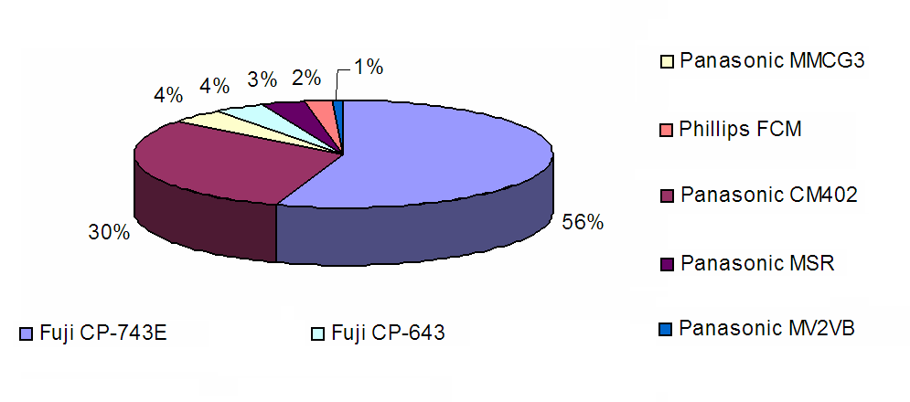
Assembly Capability:
SMT Chip Shooters
Chip Shooter Distribution – 510 Total Machines
Two machines make up 86% of mobile ODM chip shooters.

Slide 13
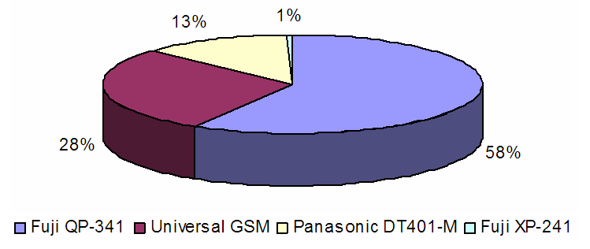
Assembly Capability:
SMT Large Component Placement Machines
SMT Placement Machine Distribution
374 Total Machines
Large Component Placement machines by ODM
 | Inventec | Wistron | Quanta | Compal | Asustek
Universal GSM Series | 27 Machines 9 Lines 3/Line | 32 Machines 16 Lines 2/Line | - | 33 Machines 11 Lines 3/Line | 14 Machines 7 Lines 2/Line
Fuji QP Series | - | - | 219 Machines 52 Lines 4/Line | - | -
Panasonic DT Series | - | 17 Machines 8 Lines 2/Line | - | 30 Machines 15 Lines 2/Line | -
Fuji XP Series | - | - | - | 2 Machines 1 Line 2/Line | -
Fuji QP feeder capacity is limited, so more
machines are needed, skewing the distribution.
Three equip. manufactures for Intel packages at mobile customers

Slide 14
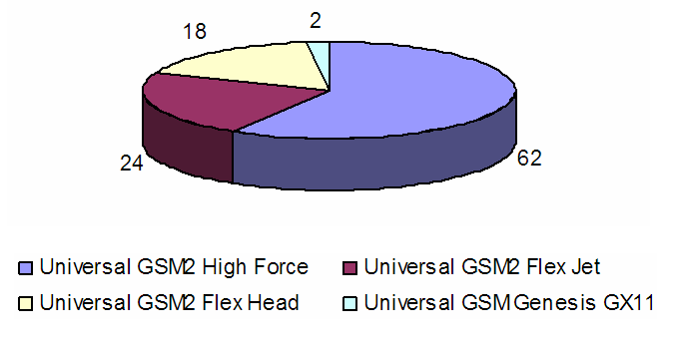
Assembly Capability:
Universal GSM Series
GSM Model Breakdown at 4 ODM’s
Different versions of GSM’s could need unique firmware upgrade levels.
Each of the 4 ODM’s has at least two versions of GSM models.

Slide 15
Assembly Capability:
SMT Process Info/Equip. Capability Matrix
SMT Process Information
Need to understand all drivers for ball recognition at each ODM.
 | Inventec | Wistron | Quanta | Compal | Asustek
Beat Rate of Intel Motherboards (Boards per Hour) | 110 | 100 | - | 120 | 105
Type of SMT Under Board Support Used | Stiffeners / Bakelite | Carrier or Support Pin | NO | Pin | -
100% BGA Solder Ball Recognition; a Requirement for BGA Placement at SMT | Yes, 60% of the balls | YES | YES, Pilot Builds | YES | Case by Case
Inspect for BGA Package Co-Planarity | NO | NO | YES, Pilot Builds | NO | NO
Equipment Capability Matrix
 | Inventec Universal | Wistron Panasonic | Wistron Universal | Quanta Fuji | Compal Universal | Asustek Universal
BGA Placement Accuracy | 50 Micron | N/A | 50 Micron | 66 Micron | 50 Micron | 50 Micron
.7 mm Pitch Capable | YES | YES | YES | YES | YES | YES
Max Component Size | 51 X 63 mm | 90 X 100 mm | 50 mm | 74 mm | 50 mm | 50 mm
Non-Grid Array Capable | YES | YES | YES | YES | YES | YES
100% Ball Recognition and Inspection for Crestline Pattern | NO | NO | NO | NO | NO | NO
Specifications Met | 4/5 | 3/5 | 4/5 | 4/5 | 4/5 | 4/5
Crestline’s number of elements exceeded all machine capability, CME mitigating by working through equipment manufactures.

Slide 16
Assembly Capability:
SMT Placement Assessment
SMT Placement Assessment
 | Inventec | Wistron | Quanta | Compal | Asustek
Customer Perception of Projected Risk for Placing Crestline | Customer not Concerned | XY Data Requested by Customer | XY Data Requested by Customer | Customer Concerned Outside Capability | XY Data Requested by Customer
Equipment Capability Matrix Score | 4/5 | 4/5 | 4/5 | 4/5 | 4/5
Firmware Upgraded for Crestline MCH Ball pattern | YES | YES | YES | YES | TBD Todd/Dan
Need discussion with equipment manufactures to fully assess.

Slide 17
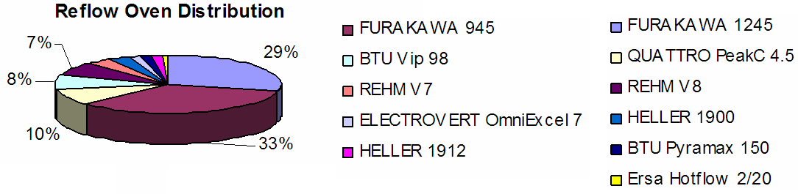
Assembly Capability:
Reflow Ovens / Process Information
All ovens were checked (YES) for being nitrogen ready)
Reflow Process Information
 | Inventec | Wistron | Quanta | Compal | Asustek
What is Used to Support Boards During Reflow | Stiffeners | Pallats | Pallats | Support only .8 mm | Carrier
Maximum Allowable O2 ppm Level | 500-1000 | 500-1500 | 0-500 | 2500-3500 | 500-1500
Are Intel CPU Sockets Put Through Inverted Reflow | NO | - | NO | YES, Second Reflow | Most CPU Sockets aren’t Put Through Inverted Reflow
Compal does inverted socket reflow with no support.

Slide 18
Assembly Capability:
Reflow Process Information
Industry Profile Specifications
 | Inventec | Wistron | Compal | Asustek
LF Soak Time (seconds) - Min | 60 | 60 | 60 | 60
LF Soak Time (seconds) – Max | 90 | 120 | 100 | 120
LF Soak Temperature (degC) – Min | 155 | 150 | 150 | 150
LF Soak Temperature (degC) – Max | 180 | 180 | 190 | 180
LF Time Above Liquidous (seconds) – Min | 60 | 40 | 30 | 20
LF Time Above Liquidous (seconds) – Max | 90 | 90 | 60 | 60
LF Peak Temperature Range (degC) – Min | 220 | 230 | 235 | 230
LF Peak Temperature Range (degC) – Max | 245 | 250 | 245 | 243
LF Temperature Ramp rate (degC/second) – Min | 1.5 | N/A | .5 | N/A
LF Temperature Ramp rate (degC/second) – Max | 3 | 3 | .7 | 3
LF Temperature Cool rate (degC/second) – Min | 1 | N/A | 2 | 2.5
LF Temperature Cool rate (degC/second) – Max | 1.8 | 3 | 3 | 3
Nominal belt speed for an Intel motherboard (cm/min) | 70 | 80-120 | 70 | 90-100

Slide 19
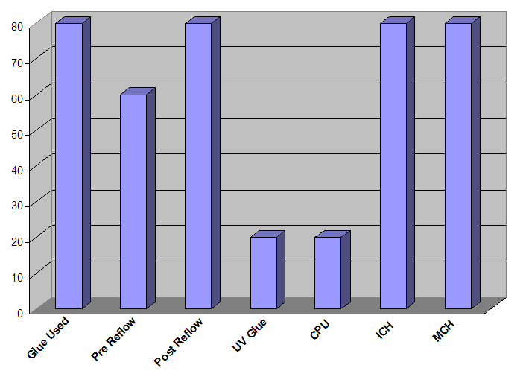
Assembly Capability:
Glue Process
Glue Process
Percentage of ODM’s

Slide 20
Assembly Capability:
Glue Process Assessment
 | Inventec | Wistron | Quanta | Compal
Glue Material | Loctite 3705 (reworkable) | Panasonic ADE480D LF (reworkable) Loctite 3515 for manual Corner Glue | Loctite 3609 Pre-SMT Corner Glue Loctite 3515, KOKI JU-100-4 | Loctite 3515 Loctite 3609
Glue Drivers | Field Failures | Dell Torsion test | Field Failures, Dell Torsion test | Field Failures, Dell Torsion test
Glue Process | Post reflow UV, Four Corner L Shapes | Pre reflow, 6 Dots per Package | Post reflow, Full Edges w/one gap & NFFUF | Pre Reflow, One Dot / Corner
Glue Contact | Good Contact | Good Corner / Edge Contact | Good Surrounding Contact | Poor Corner Contact Due to Placement Accuracy and Drop Shape
Glue Measurement | Measuring Field Failures | Confirmed 20-30% Improvement on Dell Torsion Test. Nore More Cracks Seen | Measuring Second Time Field Failures | Measuring Field Failures
Varying processes and materials exist with industry; Glue measurement metric for effectiveness needed.
Underfill Development
 | Wistron | Quanta
Underfill Material | Unknown, Need to Determine | Three Vendors Currently Working With Quanta Under NDA on No Flow Flux Underfill (NFFUF)
Primary reason for Underfill | Dell Torsion test | Field Failures
Underfill Notes | Reported 100-200% improvement in cracking under torsion. Material was not reworkable, so it was not implemented. | DOE build for Santa Rosa includes several legs with NFFUF. Time zero analysis to be completed.
Santa Rosa DOE at Quanta will yield latest underfill development data.

Slide 21
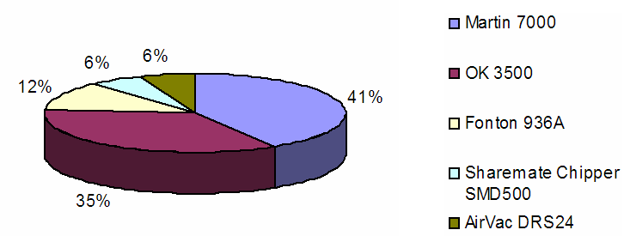
Assembly Capability:
BGA Rework Equipment and Process
BGA Rework Equipment – Machine Distribution
BGA Rework Process
 | Inventec | Wistron | Quanta | Compal | Asustek
Machine | Martin 7000 | Martin 7000,OK3500, Fonton 936A Metcal APR5000 | Martin 7000, Hippo, Quick 2005 | AirVac DRS-24, DiC (Den-on Instrument Co. Ltd Hipo HB1800, & Metcal APR5000 | Sharemate Chipper SMD500, SRT2100, SRT1100, APR5000
Paste and/or Flux Used in Rework | Paste | Only flux, unless special situation | RMAs: Flux | Both | Both depending on process
Paste | Tamura TLF 204-93(IVT) | Shenmao | - | Shenmao PF610-R | -
Flux | Amtech – MC-559-ASM | Alphametal LR725LV | FLAST 880R CS0490 | AIM NC-254 | KOKI TF-M952
Solder Cleaning Method | Contact with copper braid | Contact with copper braid | Contact with copper braid | Contact with copper braid | N/A
Rework Yield | 80% | 90% | 95% | 90% | 85%

Slide 22
Assembly Capability:
PCB Printed Circuit Board
 | Inventec | Wistron | Quanta | Compal | Asustek
Percent of Production Volume is Lead Free? | 0-25% | 25-50% | 0-25% | 0-25% | 0-25%
Laminate Material Used in a Lead Free Mobile Motherboard? | Mid Tg (150C) | Mid Tg (150C) | Mid Tg (150C) | Mid Tg (150C) | Low Tg FR-4
OSP: PCB suppliers | UMT, CT, GCE & VERTEX | GCE, Hannstar, EPC, E&E | PTP/TDT | N/A (Although Compal is near 100% OSP) | Hannstar, SFL, YuFo, Nanya, YANG AN, Circuitech, CADAC, ShyeFeng, H&T, FLEXIUM, CAREER, happy, JIT
ImAg: PCB suppliers | N/A (they don’t use ImAg) | GCE, Compeq | Hannstar, GCE, Tripod, Nanya | Hannstar, GCE, ACCL | COMPEQ
Printed Circuit Board Thickness
 | Inventec | Wistron | Quanta | Compal | Asustek
0.6 mm | - | - | - | - | -
0.8 mm | - | Few | - | - | 1%
1.0 mm | - | Minority | 20% | 5% | -
1.2 mm | 10% | Majority | 80% | 5% | 65%
1.4 mm | 90% | - | - | 10% | -
1.6 mm | - | - | - | 80% | 34%
Multiple thicknesses utilized in mobile industry.

Slide 23
Assembly Capability:
PCB Printed Circuit Board
PCB Surface Finish Chemistry
 | Quanta | Inventec | Wistron | Compal
Im Silver - MacDermid | 50% (unknown chemistry) | - | 20% | -
Im Silver - Alpha Level |  | - | - | -
Im Silver - Alpha Star |  | - | - | -
OSP - Cookson Entek Plus Cu-106A | 50% (unknown chemistry) | 33% | - | 50% (unknown chemistry)
OSP - Cookson Entek Plus Cu-106A HT |  | - | 40%
OSP - Shi Koku Kase Glicoat SMD F2 |  | 33% | -
OSP - Everchem F-22G |  | - | -
OSP - Tamura WPF-21 |  | 33% | 40%

Slide 24
Assembly Capability:
Land Diameters for BGA Ball Size
 | Inventec | Wistron | Quanta | Compal | Asustek
0.508mm Diameter Ball (20mil) | 0.46mm | 0.46mm | 0.4mm | N/A | 0.356mm
0.610mm Diameter Ball (24mil) | 0.55mm | 0.64mm | 0.45mm | N/A | 0.406mm
0.889mm Diameter Ball (35mil) | 0.8mm |  |  | N/A | 0.508mm
Inconsistency in results confirms lack of awareness of Intel Design Guidelines discovered during WW45 visit.
ODM Packaging Characteristics
        Tape and Reel is preferred over Trays
 | Inventec | Wistron | Compal | Asustek
Preferred Incoming Media: Tape and Reel or JEDEC Trays | Tape. It's faster for the SMT process | Tape and Reel | Tape & Reel is easier for pick up and placement | Tape and Reel. Increases production efficiency
Automation or Throughput time impact when comparing tape and reel to JEDEC trays | Yes, Tape and reel saves time from replacing frequently | Trays is lower than tape and reel in through put due to frequent tray replenishment | More quantity on T&R package, reduces the loading time | -
If the SMT equipment uses the JEDEC trays as the main media for BGAs as oppose to tape and reel, what's the impact | Time inefficiency due to keep on adding components to SMT equipment. | Same as above | Reduce Through put a lot | Pick up stability and production efficiency
How do you plan to handle the components that are larger than 37.5mm sq | Preferring using tape. | Tape and reel | GSM2 with special nozzle | We change nozzle size to 0.340 inch diameter (or larger) to pick up the components.
What is the environmental / recycle requirements for incoming media? | Recyclable. | Sound sealing | Recyclable. | -

Slide 25
Quality Assessment:
Max BGA Size and Ball Count per Pitch
BGA Opens/BGA Shorts
Max BGA Size and Ball Count per Pitch
 | Inventec | Wistron | Quanta | Compal | Asustek
1.0 mm | 40 X 40 mm, 600 Balls | 18 X 18 mm, 196 Balls | 27 X 27, 1257 Balls | 37.5 X 37.5 mm, 1257 Balls | 33 X 33 mm, 880 Balls
.8 mm | 18 X 18 mm, 350 Balls | 15 X 15 mm, 144 Balls | 13 X 13, 257 Balls | N/A | 16 X 16 mm, 277 Balls
.65mm | Not Used | Not Used | N/A | Not Used | Not Used
.5mm | Not Used | 2 X 2 mm, 9 Balls | In Production, Unknown Package | Not Used | Not Used
DMP for BGA Opens
 | Inventec | Wistron | Quanta | Compal | Asustek
1.0 mm | 500-1000 | <100 | 500-1000 | 250-500 | 100-250
.8 mm | 250-500 | 100-250 | 500-1000 | <100 | <100
.65mm | Not Used | Not Used | N/A | Not Used | Not Used
.5mm | Not Used | 100-250 | N/A | Not Used | Not Used
DMP for BGA Shorts
 | Inventec | Wistron | Quanta | Compal | Asustek
1.0 mm | 500-1000 | 100-250 | 500-1000 | <100 | 250-500
.8 mm | 250-500 | 100-250 | 500-1000 | <100 | 250-500
.65mm | Not Used | Not Used | N/A | Not Used | Not Used
.5mm | Not Used | 1000-2000 | N/A | Not Used | Not Used

Slide 26
Quality Assessment:
QFP yields/BGA Corner Ball Cracking
QFP .4mm pitch (16mil)
 | Inventec | Wistron | Quanta | Compal | Asustek
Max Size | 10 X 10 mm | 20 X 20 mm | 17 X 17 mm | Not Used | 10 X 10 mm
Lead Count | 80 | 144 | 120 | N/A | 64
Opens DPM | 50-250 | 50-250 | 500-1000 | N/A | <50
Shorts DPM | 50-250 | 500-1000 | 500-1000 | N/A | <50
BGA Corner Ball Crack DPM
 | Inventec |  | Wistron |  | Quanta |  | Compal |  | Asustek
Customer Line Fallout or Field return | CLF | Field | CLF | Field | CLF | Field | CLF | Field | CLF | Field
Direct Attach CPU | - | <100 | 1000 | - | 750 | 100 | - | - | - | -
MCH | - | <100 | 1000 | - | 750 | 100 | 350 | 100 | - | -
ICH | - | <100 | 250 | - | 800 | 100 | 350 | 100 | - | -
LF Direct Attach CPU | - | - | 1000 | - | 850 | 150 | - | - | - | -
LF MCH | - | - | 1200 | - | 850 | 150 | 650 | 300 | - | -
LF ICH | - | - | 300 | - | 900 | 150 | 650 | 300 | - | -
ODM’s measure DPM differently, so data isn’t trusted.
Investigation at Quanta shows failure rate is actually 32 DPM.

Slide 27
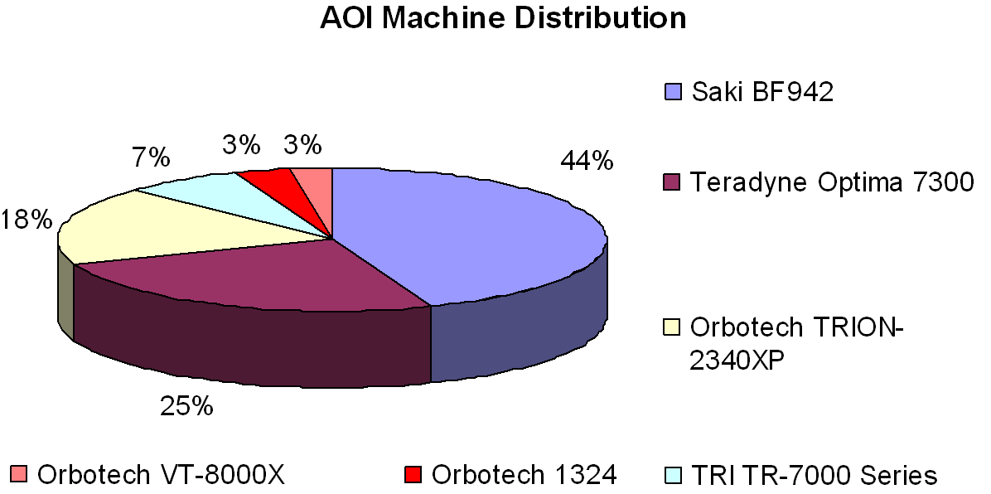
Test Capability and Procedures:
AOI / AXI Automated Optical Inspection / Automated X-Ray Inspection

Slide 28
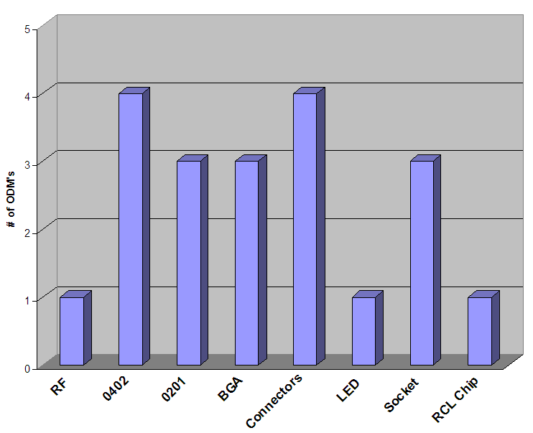
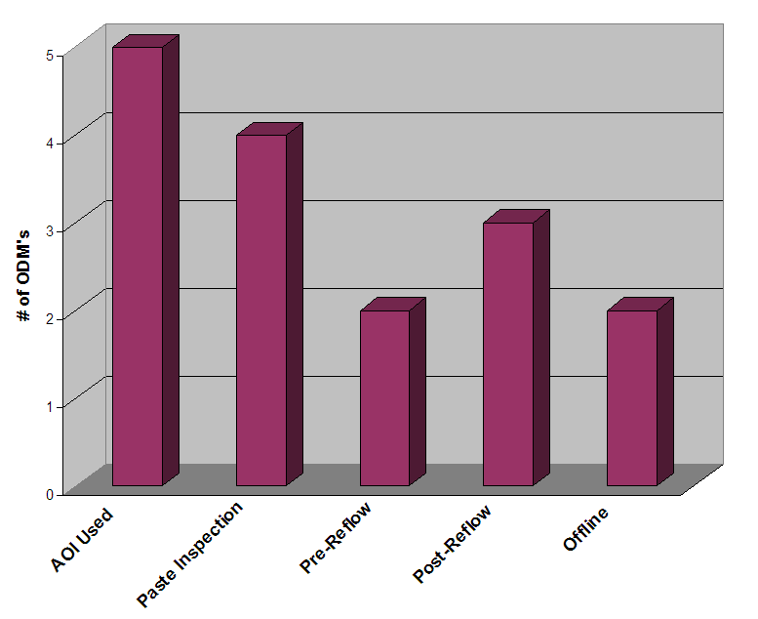
Test Capability and Procedures:
AOI / AXI Automated Optical Inspection / Automated X-Ray Inspection
Asustek is not accounted for in AOI Strategy data.

Slide 29
Test Capability and Procedures:
AOI / AXI Automated Optical Inspection / Automated X-Ray Inspection
AOI Top Three Failures of Lead Free Solder
AXI survey Notes
 | Invetec | Winstron | Quanta | Compal | Asustek
Shorts | 1 | 2 | 1 | 2 | N/A
Opens | 2 | 3 | 2 | 1 | N/A
Missing | 3 | 1 | - | 3 | N/A
Misplaced | - | - | 3 | - | N/A
None of the five mobile ODM’s use AXI in their normal manufacturing or test processes.
Quanta and Inventec have 5DX machines offline.
Winstron reports having an Agilent machine, however it is used on a server model, testing 20 boards an hour with 90-95% test coverage.

Slide 30
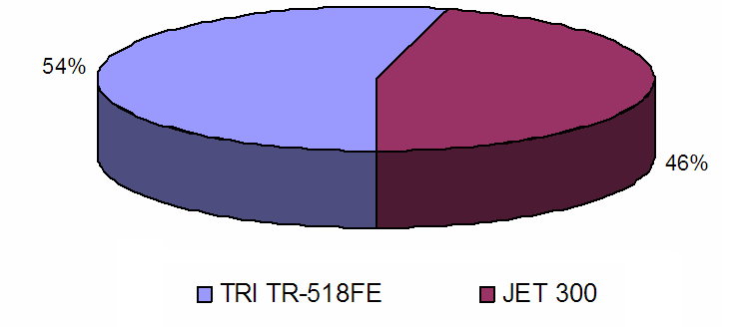
Test Capability and Procedures:
ICT In-Circuit Test
ICT (Un-Powered) Machine Distribution Throughout Mobile Manufacturing Segment
Quanta does NOT use ICT, they use ATE only.

Slide 31
Test Capability and Procedures:
ICT In-Circuit Test
ICT Top Three Failures
 | Inventec | Wistron | Compal | Asustek
Non BGA Shorts | - | 1 | 2 | -
Non BGA Opens | - | 3 | - | 2
BGA Shorts | - | - | 1 | -
BGA Opens | - | - | - | 1
Missing Component | 2 | 2 | 3 | -
Bad Component | - | - | - | 3
Connector | 1 | - | - | -
Wrong Component | 3 | - | - | -
ICT Process
 | Inventec | Wistron | Compal | Asustek
Typical Yield | 97% | 97% | 90-95% | 96%
False Call Rate | <5% | <5% | 5-10% | <5%
Test Time | 10-20 sec | 20-30 sec | 30-40 sec | 20-30 sec
VREG Circuit Tests | None | None | None | At Other Station
BGA Test Modes | Testjet; Diode Check | Testjet; Diode Check | Diode Check | Testjet; Diode Check
Typical Node Count | 500-1000 | 1500-2000 | 1500-2000 | 1500-2000
Test Point Access | 95-99% | 95-99% | 90-95% | 80-90%
CPU Socket Technique | Not Tested | Not Tested | Probing Module | Probing Module

Slide 32
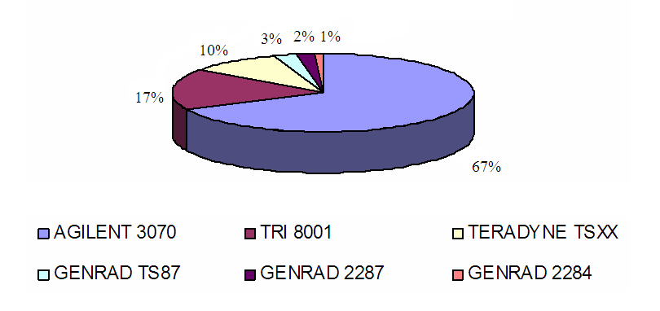
Test Capability and Procedures:
ATE Automated Test Equipment
ATE (Powered) – ATE Machine Distribution Throughout Mobile Manufacturing Segment
Asustek does NOT use ATE for testing mobile boards.

Slide 33
Test Capability and Procedures:
ATE Automated Test Equipment
ATE Top Three Failures
 | Inventec | Wistron | Quanta | Compal
Non BGA Shorts | - | 1 | 1 | 2
Non BGA Opens | - | 2 | 2 | -
BGA Shorts | - | - | - | 1
BGA Opens | - | - | - | -
Missing Component | 2 | 3 | - | 3
Bad Component | - | - | 3 | -
Connector | 1 | - | - | -
Wrong Component | 3 | - | - | -
ATE Process
 | Inventec | Wistron | Quanta | Compal
Typical Yield | >98% | 97% | >98% | 96%
False Call Rate | <5% | <5% | <5% | 5-10%
Test Time | 20-30 sec | 30-40 sec | 40-50 sec | 30-40 sec
VREG Circuit Tests | None | None | Discrete Analog Test Only | None
BGA Test Modes | Testjet; Diode Check, XOR-Tree, Nand-Tree, Boundary Scan | Testjet; Diode Check, XOR-Tree, Nand-Tree | Testjt, Boundary Scan | Feamrscan FX
Typical Node Count | 1500-2000 | 1500-2000 | 2000-2500 | 1500-2000
Test Point Access | 95-99% | 95-99% | 95-99% | 90-95%
CPU Socket Technique | Testjet | Intel Socket Test | Probing Module, Testjet,Shorting Plate | Probing Module

Slide 34
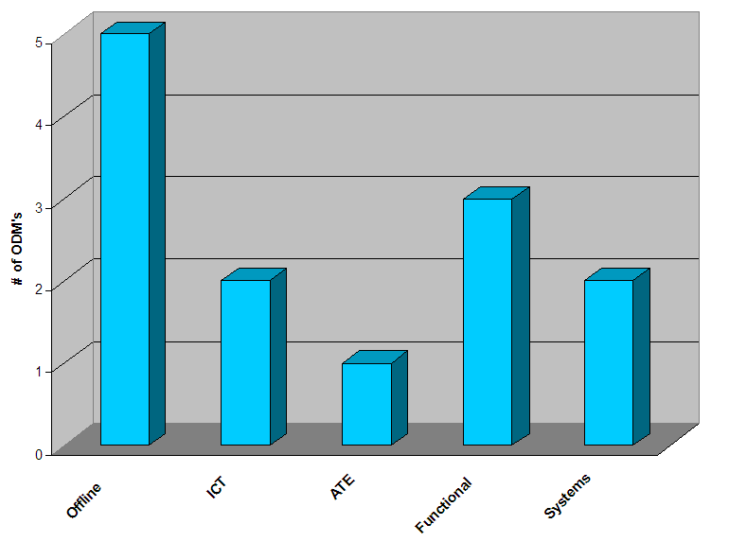
Test Capability and Procedures:
Device Programming
Device Programming – Programming Strategy

Slide 35
Test Capability and Procedures:
Device Programming
Device Programming
 | Inventec | Wistron | Quanta | Compal | Asustek
Programming Strategy | Offline | Offline, Functional, Systems | Offline, ICT, Functional | Offline, ICT/ATE, Functional Systems | Offline
Program Verification | Offline | Offline & Functional | Offline, ICT, Functional | Offline, ICT, Functional | Offline
Size | 8MB | 2MB | 4MB | <1MB | <1MB
Where MAC Addresses | Systems | Functional | ATE/ICT & Functional | Functional & Systems | Functional
Program SPI Flash | No | Yes | Yes | Yes | No
Equipment for programming /verifying SPI | - | DATA IO | AT3-300, SU-3000 & Multi-Pro HiLo, Leap, Programmed System | SFIS SYSTEM | -

Slide 36
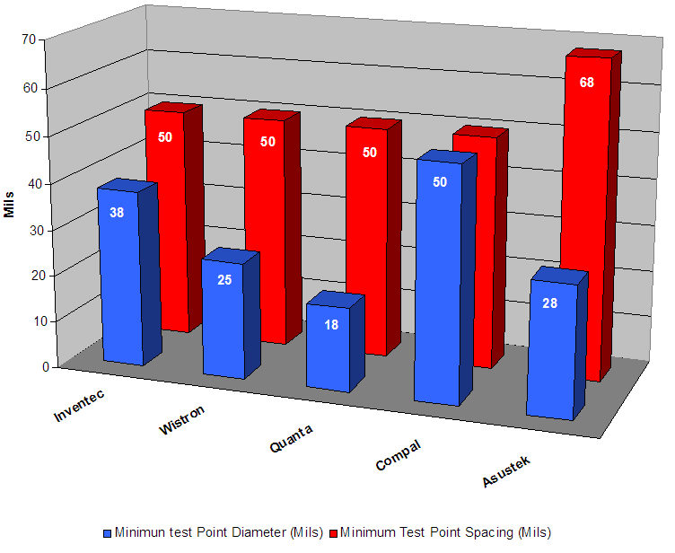
Test Capability and Procedures:
Functional Test
Functional Test – Test Points

Slide 37
Test Capability and Procedures:
Functional Test
Functional Test - Top Three Failures
 | Inventec | Wistron | Quanta | Compal | Asustek
No Boot | 1 | 2 | 1 | 3 | 2
No Video | - | 1 | - | - | 1
Failed Video | 3 | - | 2 | - | -
Audio | 2 | - | - | 2 | -
I/O Specifically: | - | 3 I/O Connector | 3 KB | 1 1394/ 5 in 1 | -
Other | - | - | - | - | 3
Functional Test - ODM Test Statistics
 | Inventec | Wistron | Quanta | Compal | Asustek
Fixtures Used at Functional Test | Yes | Yes | Yes | Yes | Yes
Typical FCT Yields | >99% | >99% | 99-95% | 99-95% | 99-95%
False Fail/Call rates | 1-5% | 1% | 1% | 1-5% | 1%
Typical Test Times | 5-10 Min | 5-10 Min | 5-10 Min | 5-10 Min | 5-10 Min
Setup & Disconnect Times Per Board | 50-60 Sec | 10-20 Sec | 20-30 Sec | 50-60 Sec | 50-60 Sec

Slide 38
Test Capability and Procedures:
Functional Test
Functional Test - ODM Test Statistics (Continued)
 | Inventec | Wistron | Quanta | Compal | Asustek
Fixture PM Schedule | Daily | Weekly | Every Shift | Weekly | Daily
Spring Forces Used | 8oz | 8oz | 4,6,8oz | 8oz | 10oz
Fixture Suppliers | ATE – Shanghai & Taiwan | Landrex, Topset | Landrex, ATE Shanghai | Landrex, Topset | Landrex, Topset, ECT
Special Probes for Lead Free | NO | NO | NO | NO | NO
Functional test Strategy | Windows | Windows, DOS | DOS | Windows, DOS, ITP | Windows, DOS
Types of Functional Test Used | Designed In-House | Supplied by Customer, Designed In-House | Supplied by Customer | Supplied by Customer, Designed in House | Designed in House
Type of Hardware Used for IO testing | Designed In-House | Commercially Available, Emulators | Designed In-House | Commercially Available, Emulators | Designed In-House
Test Through Connectors | YES | YES | YES | YES | YES
Probe Test Points | YES | YES | NO | NO | NO
CPU Backing Plates | YES | YES | YES | YES | NO
Thermal Strategy for Cooling Processors | Heat Pipe | Heat Pipe | Heat Pipe | Heat Sink and Fan | Fan Only
Video Modes tested (VGA, SDVO, LVDS) | Tested w/external monitors / instruments | Tested w/external monitors / instruments | Tested w/external monitors / instruments | VGA Only | Tested w/external monitors / instruments
FCT Hosted (Controlled by a Dedicated Computer | NO | NO | YES | NO | NO

Slide 39
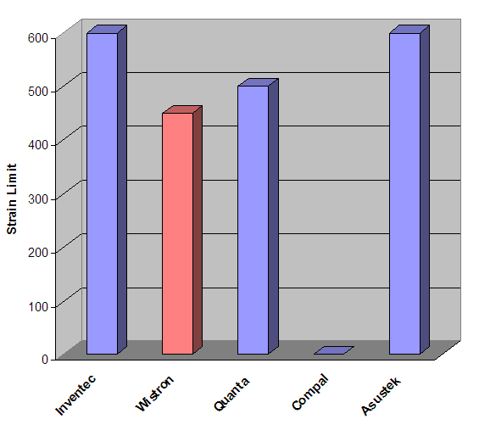
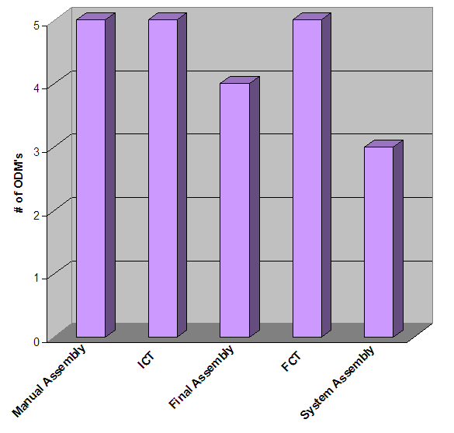
Test Capability and Procedures:
Manufacturing Stress
Manufacturing Stress – Board Flex Controlled
Manufacturing Stress – Strain Limit
Asustek doesn’t measure at final or system assembly.
Inventec doesn’t measure at system assembly.
Wistron’s Limit is set for Lead-Free.
Compal Provided no information.

Slide 40
Test Capability and Procedures:
Manufacturing Stress
Mobile Manufacturing Stress Information
 | Inventec | Wistron | Quanta | Compal | Asustek
Brand and Model of Strain Gage Equipment | Kyowa | Vishay System 6000 | Vishay | - | -
Brand and Model of Strain Gage Gages | Kyowa | Kyowa | - | - | MEMS/SM_111_32_120 & KYOWA/KFG_1_120_C1_11N3072 & KYOWA/KFG_1_120_D170_11N3072
Number of Channels Populated | 16 | 20 | 24 | 32 | 24
Scan Rate | 2K | 500 | 1K | 2K | -
Board Flex Included in PM Schedules | YES | YES | YES | YES | NO
Follow the Intel Board Flexure Specification (Board Flexure Initiative) | YES | YES | YES | YES | -
Rev. of the Intel BFI | 2.2 | 2.2 | 2 | Sept. 2004 | -
Have the Intel Calibration Fixture | NO | YES | NO | YES | NO
Metrology Used to Measure Board Flex in Functional Test | In-House Metrology | Intel’s BFI | Intel’s BFI | Intel’s BFI | Customer Specified
Fixture Suppliers Test for Strain | NO | YES | YES | NO | YES
Test Fixtures In-House for Strain | YES | YES | YES | YES | YES

Slide 41
PEI – Test Conditions
Shock
 | Drop Height | Surface | Level | Orientation
Dell |  |  | Non-op: half-sine, starting at 143G, 2ms, proceeds with 20G increments | 6 axis
Lenovo | 50cm (from knee) | Hard Floor | Board level: 100G, 2ms, ½ sine System: 210G, 3ms | 6 axis, once per axis
MEI | 30cm normal & 90cm for toughbook | Laminate wood & concrete for toughbook |  | 26 orientations: 6 faces, 8 corners, 12 horizontal / vertical lines
Toshiba | Knee Height |  | Accel is just less than 2X Intel, 2ms | 6 axis
Sony | 8 inch | Hard Laminate
Inventec |  |  | Operating: half sine, 40G, 11ms Non-Op: 240G | 6 axis
Wistron |  |  | Non-Op: 230G, 3ms | 3 axis
Quanta | 29, 36 & 48 inches |  | Operating: half-sine, 122G / 2ms Non-op: half-sine, 163G / 2ms Non-op: square-wave, 60G, 1ms | 6 axis
Intel | Not Defined | Not Defined | Board Shipping: 50G, trapezoidal, 11ms System Shipping: 30G, trapezoidal, 11ms Board End User: Half-sine, 163G, 2ms | 6 axis

Slide 42
PEI – Test Conditions
Shock
 | Board / System | Pass / Fail Criteria | Notes | Other
Dell | System | System Functional after 163G shock | Dell continues test until two failures have occurred
Lenovo | System | System Functional | Top and bottom surfaces are the worse case
MEI | System | System Functional | For MB: Worse case is bottom down and potentially corners | Sample size of 3
Toshiba | System | System Functional | Done on Shock table
Sony
Inventec | Board and System | No mechanical or electrical damage | Lasmont 65-81
Wistron | System | Visual Inspection and System Functional
Quanta | System | Visual Inspection is Okay
Intel | Board and System | System: System Functional and Crack Measurement |  | Sample size of 3 for Design Validation Sample size of 30 for Reliability Validation

Slide 43
PEI – Test Conditions
Vibration
 | Profile | Input Acceleration | Axis | Duration
Dell | Random 2 Hz @ .00005 g2/Hz to 600 Hz @ .00002 g2/Hz (12 break points) | Non- Op: 1.3 GRMS Other: HALT, 10 to 50GRMS, stepped in 5 GRMS increments | 6 sides | 30 min/side
Lenovo | Random, with a heavy object on the top or bottom of system | 1.04 GRMS |  | Several hours seen strain up to 1100ue
MEI | No Power: Random, 10-1000Hz Powered: Random, 5-55Hz sweep | Non-Op: 1.72 GRMS, Toughbook is 7.7 GRMS, Powered: 0.5 GRMS | 3 axis | No Power: 60 min/axis Powered: 10 min/axis
Asustek | Sine and Random | 0.5GRMS | 3 axis | 112 minutes
Inventec | Sine and Random | 0.5, 1.0, 1.5, 3.5 GRMS | 3 axis
Compal | Random 10-500Hz | Non-Op: 3.5 GRMS | 3 axis | 30 min/axis
Wistron | 2-600Hz | 1.2 GRMS | 3 axis | 30 min/axis
Quanta | Random | Powered: 0.66 GRMS |  | 30 min/side
Intel | Random 5 Hz @ 0.01 g2/Hz to 20 Hz @ 0.02 g2/Hz (slope up) 20 Hz to 500 Hz @ 0.02 g2/Hz (flat) | 3.13 GRMS | 3 axis | 10 min/axis

Slide 44
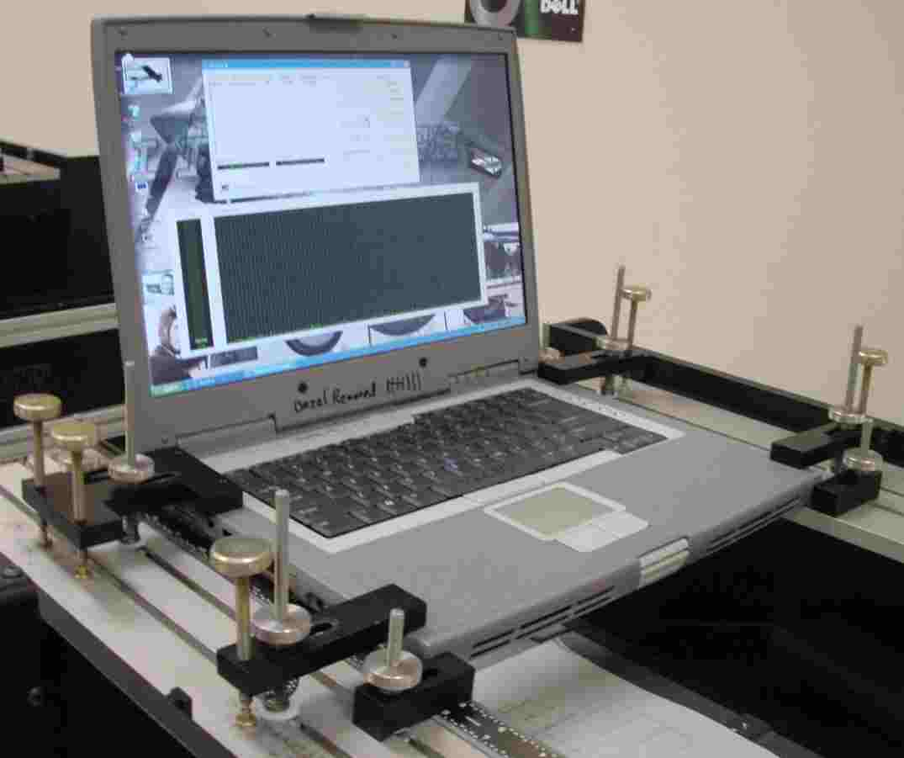
PEI – Test Conditions
Mechanical Fatigue
  DELL performs proprietary Torsion Test .
    Torsion Test is meant to simulate the stresses that the base of the system is exposed to when a user carries the system with the lid open
    This is accomplished by applying repetitive flex/twist forces to the left and right sides of the notebook base assembly and to the top edge of the LCD cover assembly
  Three ODMs have added a glue process to glue BGAs during SMT assembly for product to meet DELL torsion test requirements.
  Glue process can impact package capability.
  MEI tests for flexure / deflection with a 60kg load for 1 minute in center of top with laptop closed.
DELL | Torsion Test
Intel | Not Defined

Slide 45
PEI – Test Conditions
Temperature Cycling
 | Min / Max Temp | Ramp Rate | Dwell | Total Cycle Time or Cycle Count | Notes
Dell | Sys: -40C / 65C Brd: -40C / 80C | 40C/min | 20 min 15 min | 50 cycles | Thermal Shock Chamber or HALT Chamber
MEI | -40C / 110C |  | 15 min | 1600 cycles
Inventec | -40C / 80C -20C / 120C | 5 min per transition | 10 min 30 min | 20 min 60 min | Single Zone Chamber
Compal | Sys: -40C / 65C Brd: 0C / 100C | 40C/min | 20 min | 50 min 1000 cycles | Single Zone Chamber, Liquid to Liquid
Wistron | -45C / 85C |  | 10-15 min | 2000 cycles 2 cycles/hr | Single Zone Chamber, Air to Air
Quanta | Sys: -40C / 65C Brd: -40C / 125C | 30C/min 20C/min | 20 min 10 min | 50 cycles 1200 cycles
Intel | -55C / 125C (Condition Dependent) | 30-40C/min | 10-15 min, occasional 90 min | TCB: (Condition Dependent) | Air to Air, Dual Zone

Slide 46
PEI – Test Conditions
Humidity and Temperature
 | Min / Max Temp | RH | Duration | Bias HAST | Notes
Asustek |  | 20% to 85% | 48 hours | No | 6pcs per month per model
Inventec | 0C, 50C, 70C | 90% | 168 hours
Compal | -40C to 65C | 10% to 90% | 84 hours | No
Wistron | 85C | 85% | 600 hours | 5V bias
Quanta | Op: 0C to 30C Non-Op: -40C to 65C | Op: 10% to 90% Non-Op: 10% to 95%
Intel | 30C to 130C (Condition Dependent) | 60 to 85% | Condition Dependent | Product Dependent

Slide 47
PEI – Test Conditions
Constant Elevated Temperature (bake test)
 | Temp | Duration
Inventec | 70C | 168 hours
Quanta | 50C Powered @ 20% RH 82C Non Op @ 20% RH
Wistron | 125C
Intel | 100C, 125C, 150C | Condition Dependent

Slide 48
PEI – Test Conditions
Electroshock / ESD
 | Test Condition
Asustek | Testing Criteria Air discharge and test times: 10 times, 1 time /sec (exclude I/O Port Pins) ±8 kV, No Failures Contact discharge and test times: 10 times, 1 time /sec (exclude I/O Port Pins) ±4 kV, No Failures
Compal | Follow IEC 61000-4-2 test criteria (a)Air discharge: 4KV criteria A, 8KV criteria B, 12KV criteria B, 15KV criteria B (b)Contact discharge: 2KV criteria A, 4KV criteria B, 6KV criteria B, 8 KV criteria C Criteria A: this system and display work must normal and display did not have any flash status Criteria B: this system work must normal and display can flash status but need auto recovery to normal mode. Criteria C: the system reboot need work normal if system test occurred on any damage.
Wistron | contact +-8KV non-contact +-4KV
Quanta | Air:8KV/15KV Contact:6KV/8KV. Acceptance Criteria = No soft error/No hardware damage. Done at system level.
Intel

Slide 49
Information Source:
Mobile Industry Survey Q4’05
Digitimes Magazine
Customer Account CQE’s (Harry Yu, Claudia Zhou, Johnny Woo, Patrick Chen
APAC CME CQE (Connos Tai)
Montevina CFP Q4 ‘06

Slide 50
Backup

